Slide 1



SIH Senior Hardware Edition
Team Name : Sustainable Daily
Team ID : 22620
Institute : Deen Dayal Upadhyaya College, University Of Delhi
PSID : SM962
Team Members : Sourav Patel Rohan Singh
Milan Singh Amber Mishra
Ayushi Dixit Rohan Joshi

Slide 2
PROBLEM STATEMENT
Road Accidents due to Commercial Vehicles

Slide 3
Facts Supporting The Problem
India contributed to 11% of global road accidents and was ranked First among road deaths (WHO report 2018) and continues till date
Indian National Highways (NH) is meagre 5% of country’s Road Network but accounts for 55% of road accidents and 61% of road deaths. Majority of traffic is ferried by commercial vehicles and this in turn increases the probability of them being involved in road accidents.
In 2018 ,1.5 Lakh death due to accidents occurred in India in which 10% deaths were accounted to truck drivers

Slide 4
Target
Making a device which is pocket friendly and user friendly
Ensuring that a healthy driver drives the vehicle
Tracking and Monitoring Vehicle
Accident alert

Slide 5
Approach
Our device main work is to ensure that when the truck is to begin its journey, the driver is in perfect state to drive .If this condition is not met the truck cannot start
The GPS in the device monitors the location and speed of the vehicle and performs Geo-fencing. The ESP-32 cam does live time monitoring and records the data on the server
Incase of a mishappening, alert is sent to the fleet owner so that necessary steps could be taken.

Slide 6
Working

Slide 7

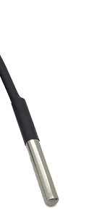






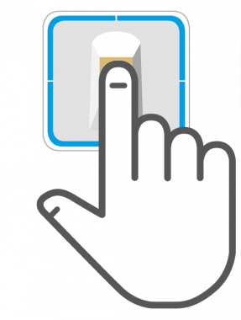
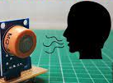






ESPcam
Recording
A
Temperature sensor
If the conditions are met only then will the truck start
If data of both device match
Turn on the switch
Heart rate/SPO2 sensor
Ignition key
Display on
TFT
Switch
Alcohol sensor
Air Quality
Fingerprint
GPS location
Temperature and humidity sensor
Monitoring
Sending
Speed monitoring
Geo fencing
Accident alert to fleet owner

Slide 8
Features
COMPONENTS | PRICE (in ₹)
Fingerprint Sensor | 865
Max 30102 (Heartrate and SpO2 sensor) | 350
DS18B20 (Body Temperature Sensor) | 100
MQ3 Sensor (Alcohol Sensor) | 150
DHT22 (Temperature and Humidity) | 400
ZP07-MP503 (VOC Sensor) | 400
MHZ 19 CO2 Sensor | 2800
GPS SIM28ML | 700
ADXL335 Accelerometer | 400
ESP32 ( X 2) | 900
RELAY MODULE | 50
ZERO PCB (X 2) | 100
 | TOTAL COST = 7,215
Measurement of Heartrate and SpO2.
Measurement of body temperature.
Tracking of vehicle using GPS.
Uploading data to website.
Sending alert on detection of accident
In our model we are using fingerprint sensor for
identity verification of the truck driver.
To check intoxication we are taking help of MQ3 sensor
which will measure alcohol concentration.
In order to check the cabin’s Air Quality we are using :
DHT22 sensor for temperature and humidity.
ZP07-MP503 (VOC sensor) for detection of volatile organic compounds .
MHZ-19 CO2 sensor to measure concentration of CO2 in atmosphere.

Slide 9
Future plan
Software
Better fail safe
Developing a website which serves our devices
Making a program for interaction of fingerprint and face detection
Hardware
Dealing with the sensitivity of the finger print sensor

Slide 10
Targeted Sector
Manufacturers of commercial vehicle

